Slide 1


Comparison of CE,CC and CB configuration of an amplifier
ACTIVE LEARNING ASSIGMENT
Subject :- Basics Of Electronics Engineering (01EC0101)
Guided By :- Prof. Chandrasinh Parmar
Presented By:-
Name:- Aryan Dilipbhai Langhanoja
Semester :- 1st
Enrollment No:- 92200133030

Slide 2
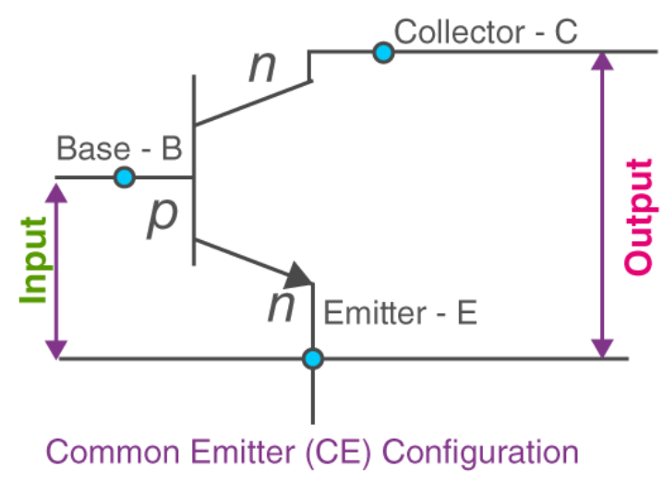
CE- Common Emitter
Parameters
Voltage Gain | Large
Current Gain | Large
Input Resistance | Medium
Output Resistance | Medium
Phase Shift | 180 Degree
Applications | Power Amplifiers. For Amplification Of Audio Audio Frequency Signal

Slide 3
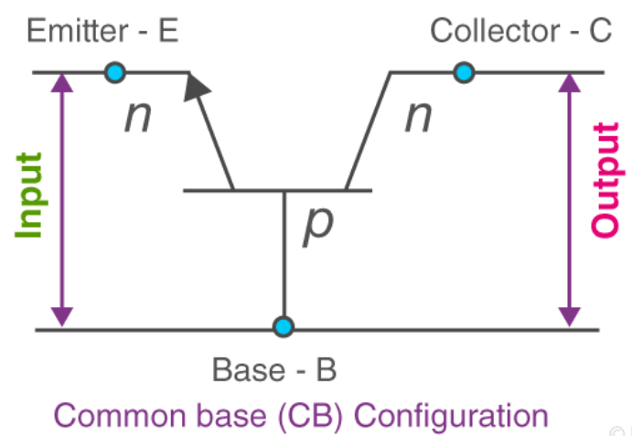
CB- Common Base
Parameters
Voltage Gain | Large
Current Gain | Almost 1(Current Buffer)
Input Resistance | Small
Output Resistance | Large
Phase Shift | 0
Applications | Current Buffer

Slide 4
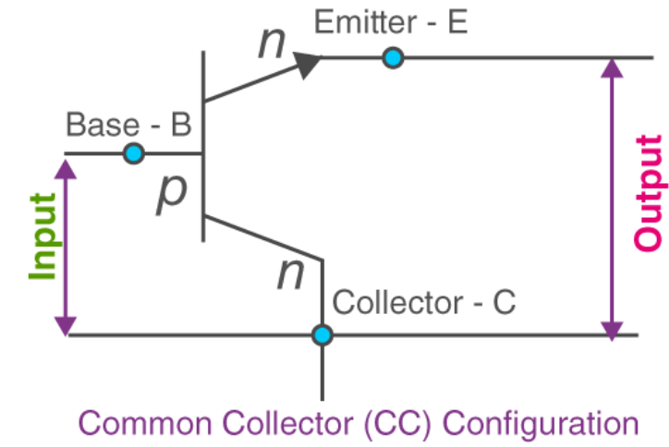
CC- Common Collector
Parameters
Voltage Gain | Almost 1(Emitter Follower)
Current Gain | Large
Input Resistance | Large
Output Resistance | Small
Phase Shift | 0
Applications | Voltage Buffer

